Slide 1
Classification of Alcoholism
Group 124 (CS)
Nathan Bui, Ryan Bui

Slide 2
Introduction and Motivation
Our project attempts to classify alcoholics through machine learning, utilizing previously recorded EEG data.
Our motivation is derived from the fact that alcoholism is a major problem within our society. Therefore, we wanted to determine how severely alcoholism affects one’s mental states, and from this be able to identify those who are suffering from this disorder.

Slide 3
Related Work
In regards to class content, our project relates to topics discussed within the BCI Review. To be specific, our project is classification, so it was necessary for us to use feature selection methods to “maximize our performance”. Specifically, we analyzed the importance of each sensor, or feature, in regards to our results.
Outside of class, there is BCI-based study that is very similar to our own research. In this study, they recorded EEG signals and analyzed the differences between drunk and non-drunk subjects.

Slide 4
Data Explanation
Data
From a large study to examine EEG correlation from genetic predisposition to alcoholism
Data was recorded with 64 electrodes on subjects scalp at standard sites for a period of 1 second
Two different groups: alcoholic and control
Subjects were given three different kinds of stimuli where they were shown either one picture, two identical pictures, or two different pictures
During this study, there were 122 subjects and each subject complete 120 trials
Because the data set was very large, we focused on the data where the subject was shown only one picture and limited the number of files used
Citation:
UCI Machine Learning Repository
Link: https://archive.ics.uci.edu/ml/datasets/eeg+database
Owner: Henri Begleiter, Neurodynamics Laboratory, State University of New York

Slide 5
Methods
Implementation
Used Anaconda as our main library and package manager
Jupyter Notebook was our coding platform
The main packages we used to develop our model was sklearn and pandas
For data analysis, we used numpy, seaborn, and matplotlib

Slide 6
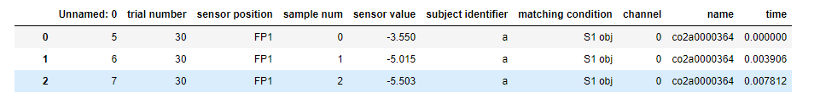
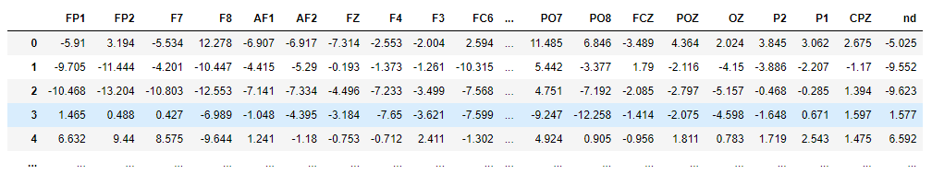
Cleaned up dataset
Removed specific features of the original data and only used sensor position, subject identifier, and sensor value to create our models.

Slide 7
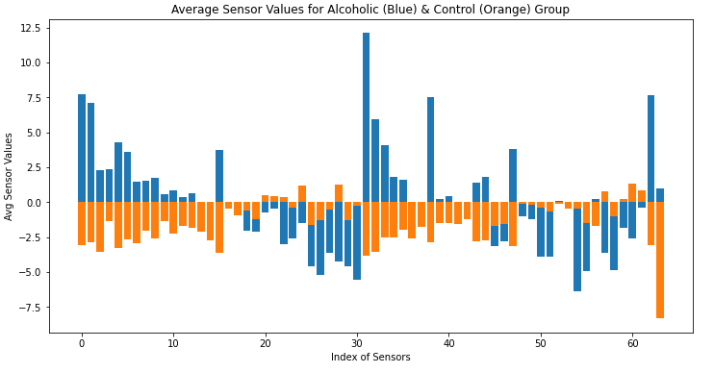
Exploratory data analysis
After cleaning up the dataset, we dived into the data to develop a better understanding, as well as seeing if there was any interesting correlations.
The main graph (shown below) we generated compared the average sensor values of each sensor, between the control group and the alcoholic group.

Slide 8
Training and Test Data
80/20 Split
Data was shuffled before the split and the data was separated based on different time points

Slide 9
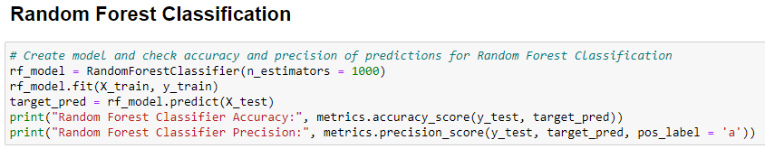
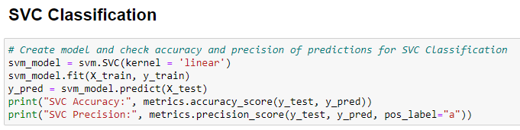
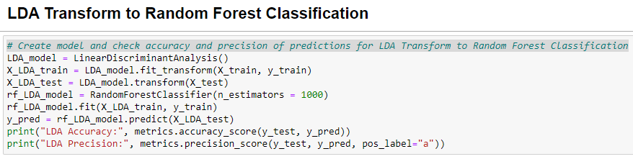
Classifiers
Random Forest Classifier
Performs both regression and classification task
Good predictions and handles large datasets
Check Feature Importance
SVC Classifier
Memory efficient
Effective in high dimensional spaces
LDA Transform into Random Forest Classifier
Dimension reduction while keeping the original level of information

Slide 10
Results: Sensor as Features
Classifier | Accuracy | Precision
Random Forest | 0.9853515 | 0.9919517
SVC | 0.9082031 | 0.9133064
LDA Transform | 0.8457031 | 0.8251879

Slide 11
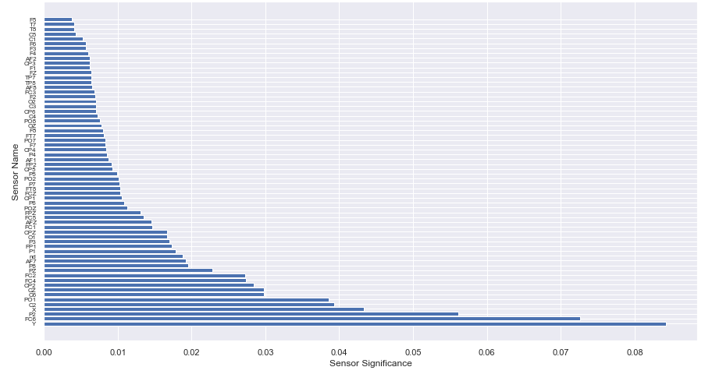
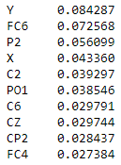
Top Ten Significant Sensors

Slide 12
Results: Top Ten Sensor as Features
Classifier | Accuracy | Precision
Random Forest | 0.9677734 | 0.9700598
SVC | 0.8291015 | 0.8097928
LDA Transform | 0.7050781 | 0.6884328

Slide 13
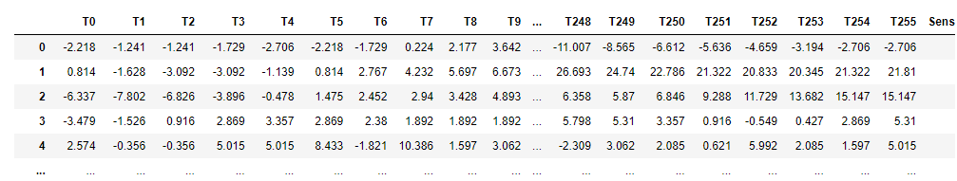
Reorganized Data
Features based on 256 different time point in the span of 1 second

Slide 14
Results: Time Points as Features
Classifier | Accuracy | Precision
Random Forest | 0.90625 | 0.9083969
SVC | 0.8007812 | 0.8076923
LDA Transform | 0.7890625 | 0.7984496

Slide 15
Results: Final
Sensor as Features produced the best models
Random Forest Classifier showed the best accuracy and precision across all the models
Correlation between alcoholic and EEG data
What went wrong
Accuracy and Precision decreased as we attempted to manipulate the data
Trouble organizing the data to ensure that all factors were held accountable

Slide 16
Discussion
What we learned
How to analyze, filter, and clean EEG datasets
Based on the accuracy and precision values we obtained, it can be assumed that there is a difference between alcoholic and non-alcoholic individuals when focused on the electrical activity of one’s scalp
Some improvements
For our classifier, we only used the data for one stimulus within the dataset. For the future, it may improve the performance of the model if we included more data
We could have used more, different classification models to compare/improve performance
Further understanding the ways we can use algorithms to understand the data
The time period being 1 seconds seems too short and should possibly be extended to account for more variability

